Slide 1
Data Structure In R
Data structures in R are objects that are used to store and organize data. They are essential for efficient data manipulation and analysis. R has a variety of data structures, each with its own strengths and weakness.
The most common data structures in R are :
Vectors
Matrices
List
Data Frames

Slide 2
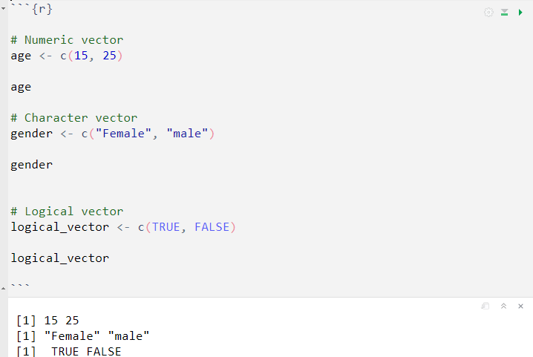
Vectors
A vector is a fundamental data structure used to store a collection of elements of the `same data type`. it can be thought of as a one-dimensional array that holds values and those values can be numeric, character, logical or other types.
Creating Vectors:

Slide 3
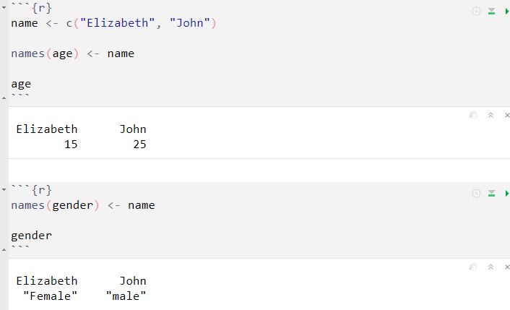
Named vector
A named vector consist of a collection of elements with each element having a name or an identifier associated with it.

Slide 4
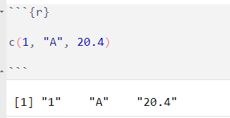
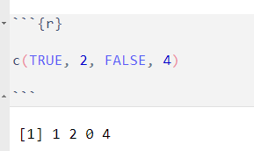
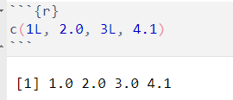
Coercion
The process of coercion involves converting or transforming data from one type to another to ensure consistency within the vector.
If you combine numeric data with character data, R will convert all the elements into character data.
If you mix logical data (TRUE/FALSE) with numeric data, R will convert all the elements into numeric data (TRUE -> 1, FALSE -> 0).
If you combine different numeric types (e.g., integer and double), R will convert all the element to the more general data type (double)

Slide 5
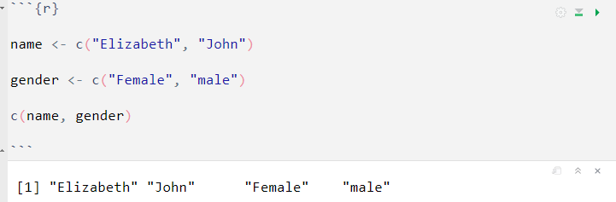
Combine multiple vectors
R can combine multiple vectors using the c() function, so it is important you understand the underlaying data type to avoid coercion.

Slide 6
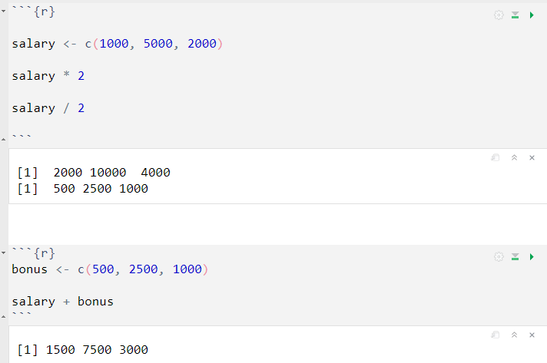
Vectorization
Vectorization is a powerful concept in R, where operations are applied to entire vectors instead of individual elements. When using vectorized operations, R automatically loops through each element of the vectors and performs the operation efficiently.

Slide 7
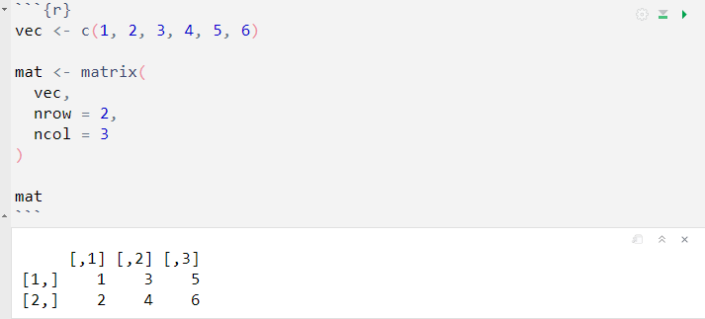
Matrix
In R, a matrix is a two-dimensional data structure that consists of rows and column, where each element in the matrix is of the same data type.
Creating a Matrix
You can create a matrix if R using the matrix() function. The matrix() function takes the date elements.

Slide 8
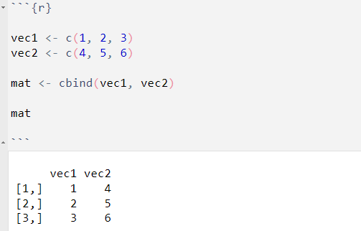
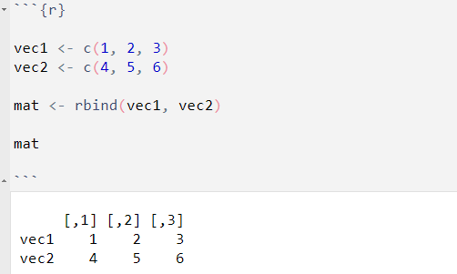
cbind()
Alternatively, you can also create a matrix using the cbind() function which bind vectors column-wise
rbind()
You can also create a matrix using the rbind() function which binds vectors row-wise

Slide 9
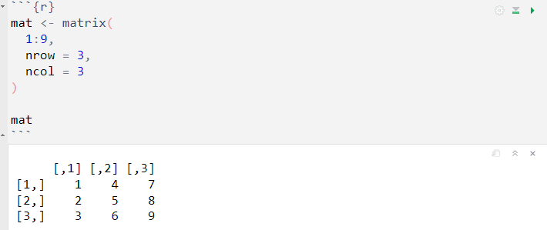
Accessing Elements in a Matrix
You can access elements in a matrix using row and column indices inside square brackets.
Create the Matrix

Slide 10
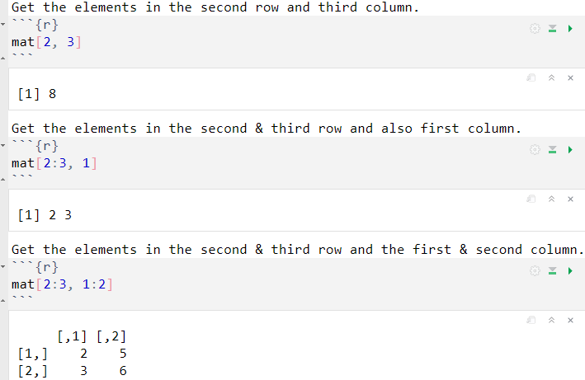
Get the elements :

Slide 11
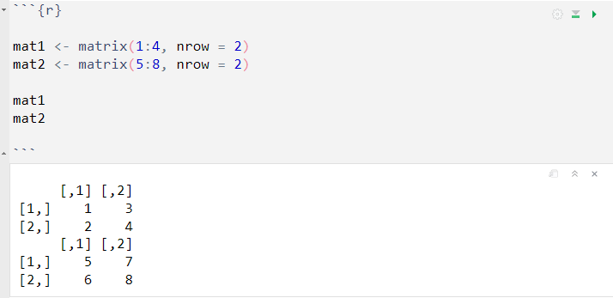
Matrix Operations
Matrices in R support various mathematical operations, such as addition, subtraction, multiplication, and transposition.

Slide 12
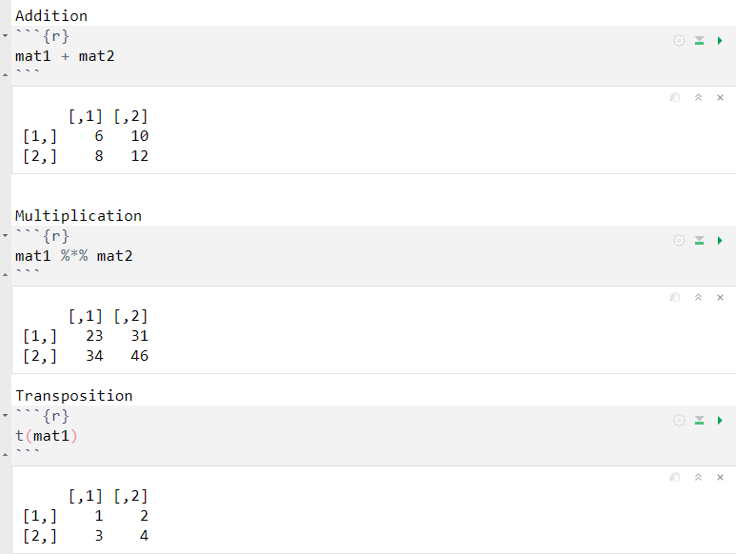

Slide 13
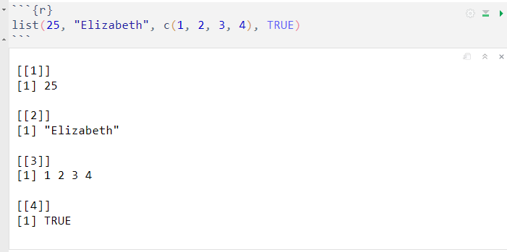
List
In R, a list is a versatile and powerful data structure that can hold elements of different data types. Unlike vectors and matrices, lists can store heterogeneous data, such as numeric values, character strings, other lists, or even functions.
Heterogeneous elements
Lists can contain elements of different data types. This flexibility allows you to organize and store diverse information together in a single data structure.

Slide 14
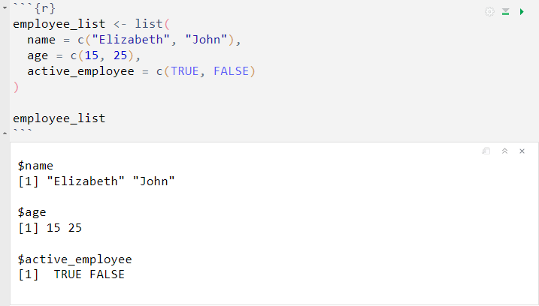
Named Elements
List elements can be given names, making it easy to access and manipulate specific elements within the list.

Slide 15
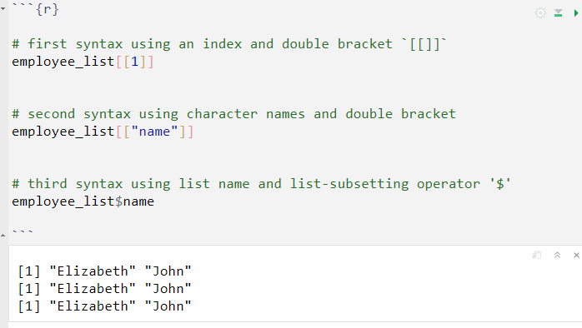
Accessing Elements
In R, you can access elements in a list using different methods, depending on whether you want to access them by their index or their names.

Slide 16
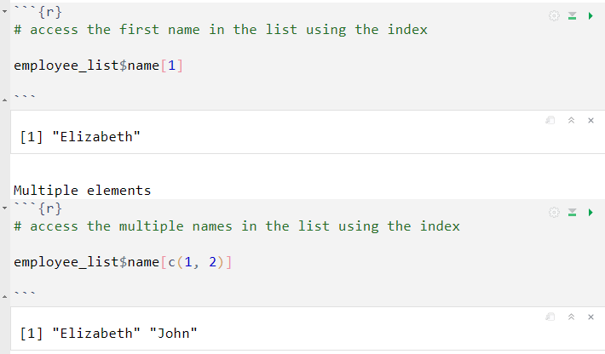
Accessing the elements inside a list element

Slide 17
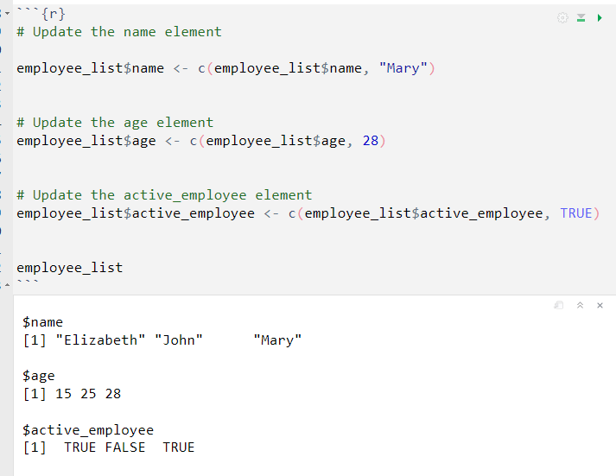
Adding elements to a list
To add new elements, we will use the ( $ ) operator to access the top element in the list and use the c() function to concatenate the new elements with the existing vector.

Slide 18
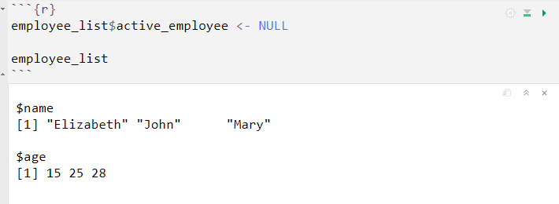
Deleting element
You can use the NULL value to indicate that the item should be removed. Setting an element in a list to NULL effectively deletes that particular element.
All elements :

Slide 19
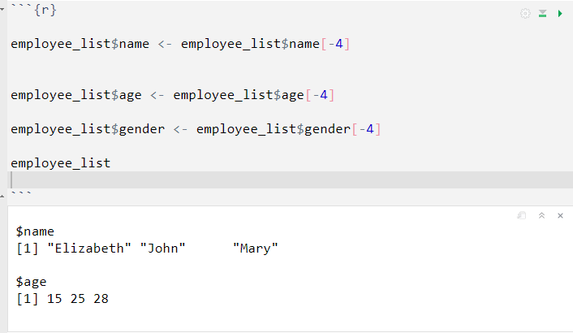
Deleting single elements using index
To delete single elements from a vector in a list, you can use indexing and subsetting.

Slide 20
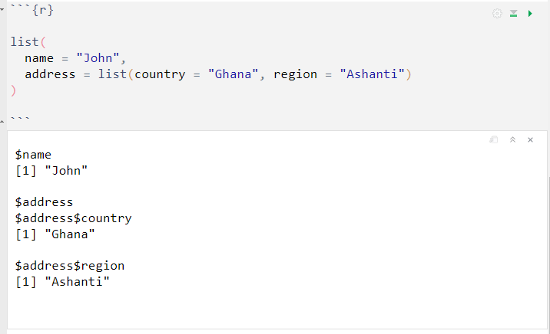
Nested List
Lists can contain other lists as elements, creating a nested data structure. This allows you to organize complex data hierarchically.

Slide 21
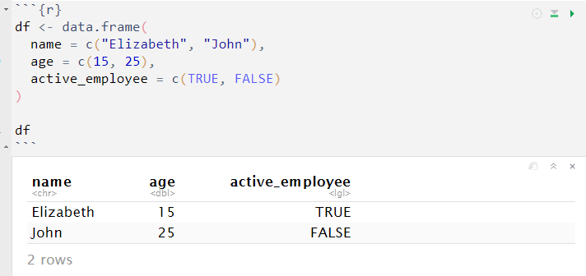
Dataframe
In R, a dataframe is a two-dimensional data structure that is similar to a spreadsheet. It is one of the most commonly used data structures in R for data manipulation and analysis. Dataframes are especially well-suited for working with structured and tabular data.
Creating a Dataframe:

Slide 22
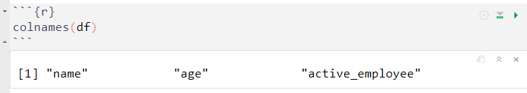
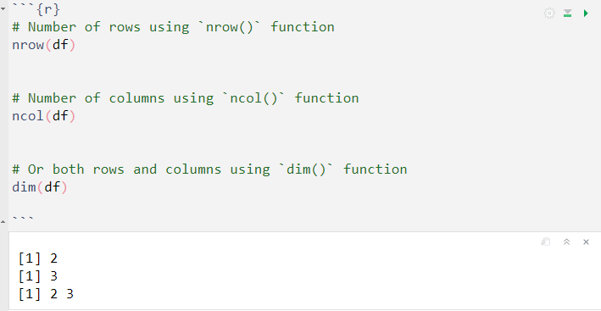
Access the column names using colnames() function
Get the number of rows and columns :

Slide 23
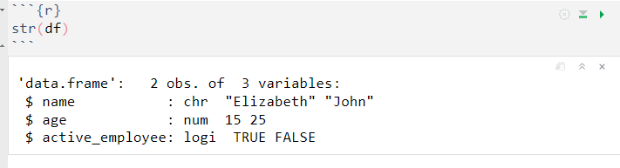
Display the structure of a dataframe
Using the str() function which is a diagnostic function for checking important elements in a dataframe.

Slide 24
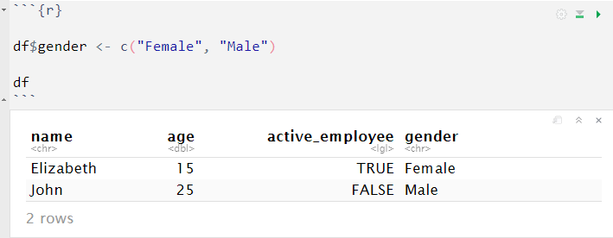
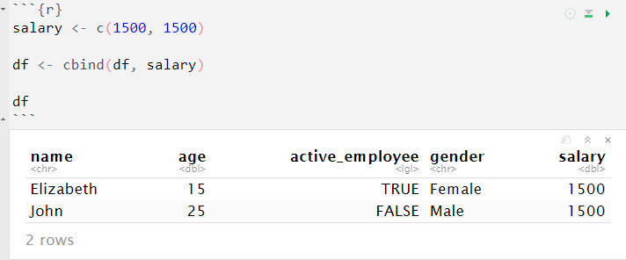
Add new column
To add a new column to a data frame, you can simply assign a vector of values to a new column name within the data frame.
Or using cbind() function

Slide 25
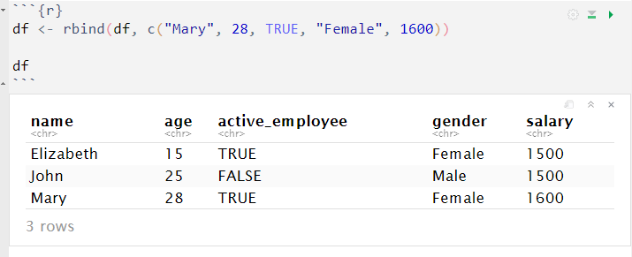
Add new row
We can add new records (rows) using the rbind() function.

Slide 26
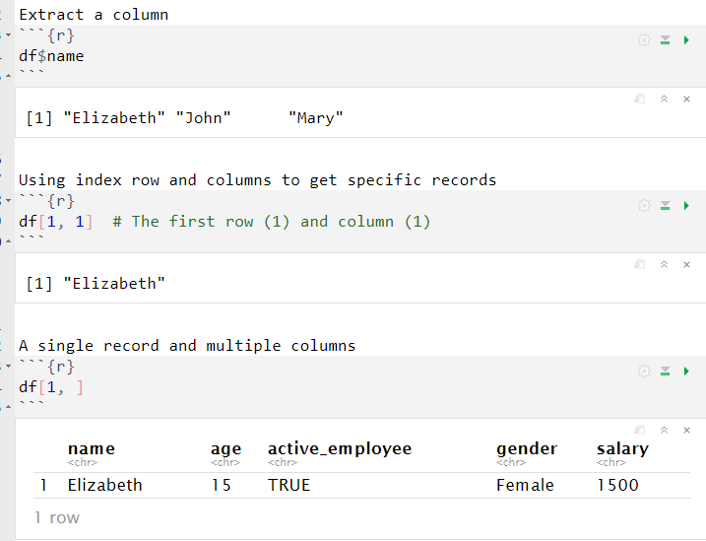
Accessing records in a dataframe

Slide 27
